Slide 1

Module 3 –In Memory Computation
Spark Operations

Slide 2

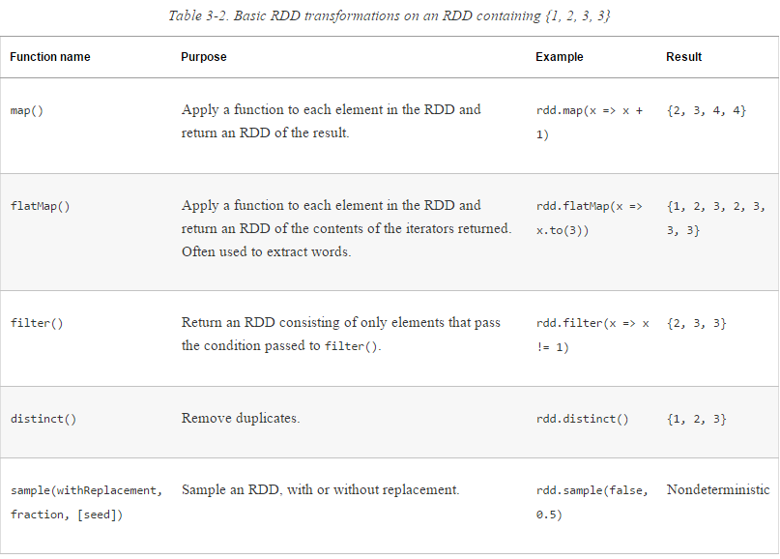
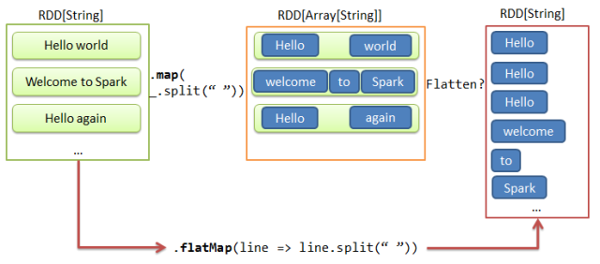
BIG DATA
Transformations

Slide 3
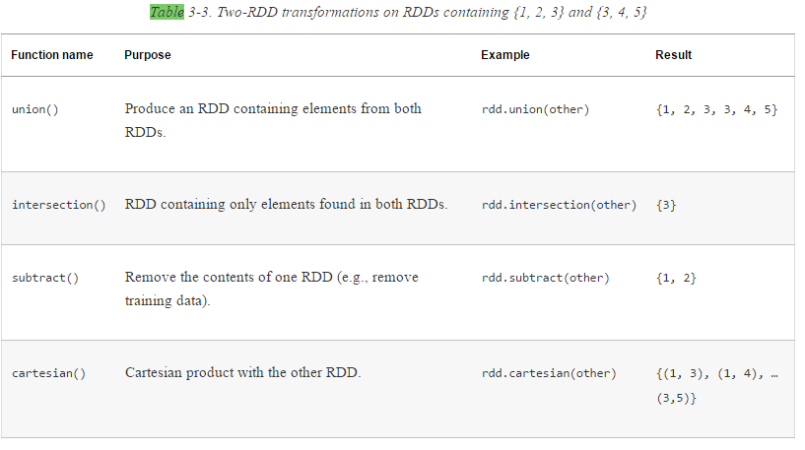
BIG DATA
Transformations

Slide 4
BIG DATA
Transformations - Filters
Strip down the RDD to get the information of interest
Basically this creates a smaller RDD
Find the minimum temperature observed at various weather stations

Slide 5
BIG DATA
Transformations - Filters

Slide 6
BIG DATA
Transformations – map() and flatmap()
Map()
She is my best friend
SHE IS MY BEST FRIEND
flatmap()
She
is
my
best
friend
She is my best friend

Slide 7
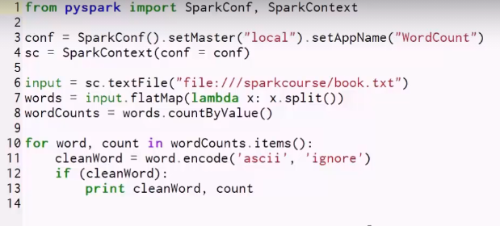
BIG DATA
Transformations – Word Count in Spark

Slide 8
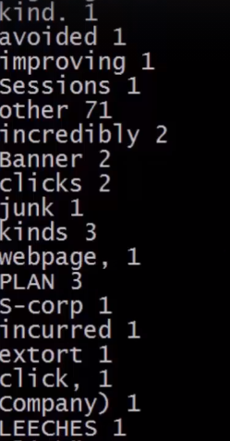
BIG DATA
Transformations – Word Count in Spark

Slide 9
BIG DATA
Transformations – Word Count in Spark
How do I deal this problem of punctuation?

Slide 10
BIG DATA
Word Count in Spark
Create a spark context: tell Spark to create a new job
val sc = new SparkContext(new SparkConf().setAppName("Spark Count"))
val tokenized = sc.textFile(args(0)).flatMap(_.split(" "))
val wordCounts = tokenized.map((_, 1)).reduceByKey(_ + _)
Read in text file
Split it into words
Each of these is an RDD
Reduce by key. Can also use countbykey
Map each word to 1
https://docs.cloudera.com/documentation/enterprise/5-13-x/topics/spark_develop_run.html

Slide 11
BIG DATA
Actions
Are operations that return a value
For example:
Reduce() is an action
Aggregates all elements of a RDD to produce a result.

Slide 12
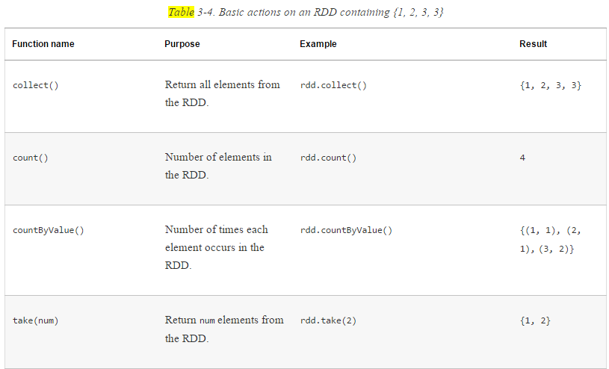
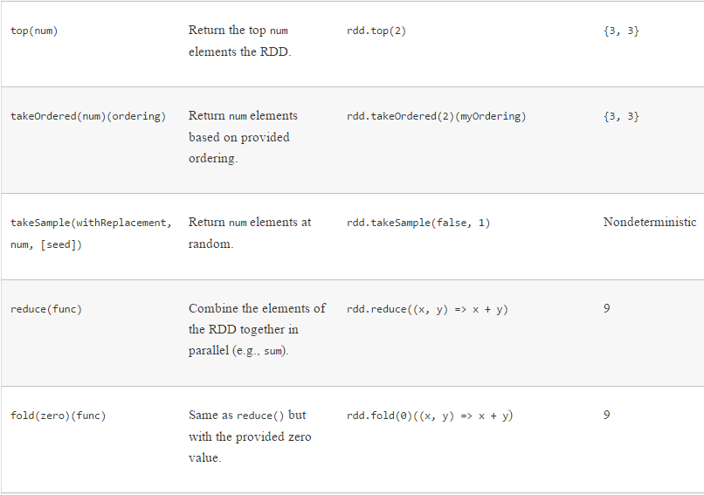
BIG DATA
Actions

Slide 13
RDD Operations : Working with key-value pairs
Notes:
Exercise
Write a similar program for
Finding the words in a file
For each word, calculate the count
Assume the file contains the string
“To be or not to be”
Hint
This should be done in parallel
In the blue boxes, read in each line in the file
If the line is w1 w2 w3 w4, then output 4 lines w1 1 w2 1 w3 1 w4 1

Slide 14
BIG DATA
Key Value Pairs
Consider our earlier operation of map/reduce using Spark
Worked on datasets with only single values
Let’s consider how to represent <key, value> pairs
Spark provides
Separate RDDs called pair RDDs for this
Separate operations to function on Pair RDDs

Slide 15
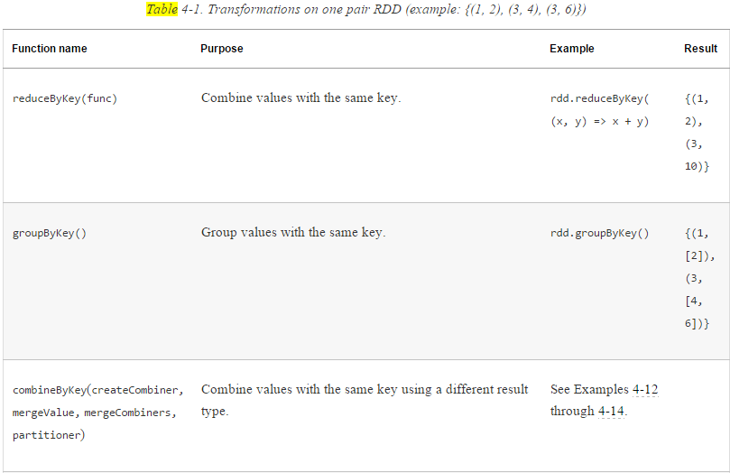
BIG DATA
Pair RDD Transformations

Slide 16
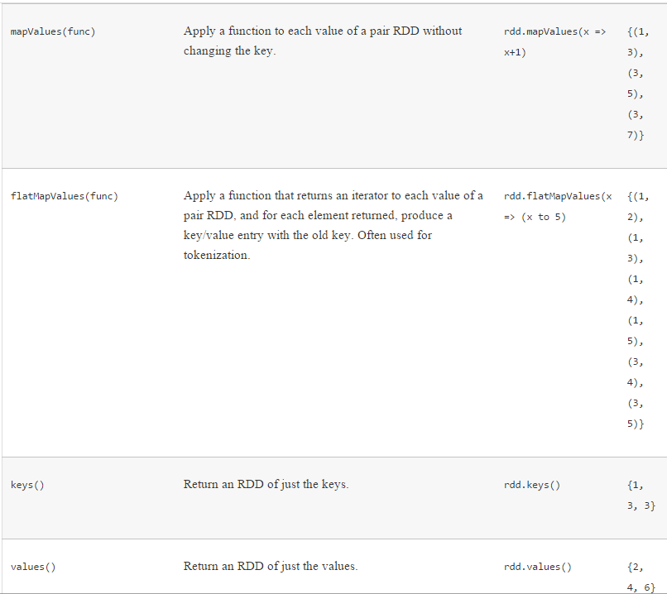
BIG DATA
Pair RDD Transformations

Slide 17
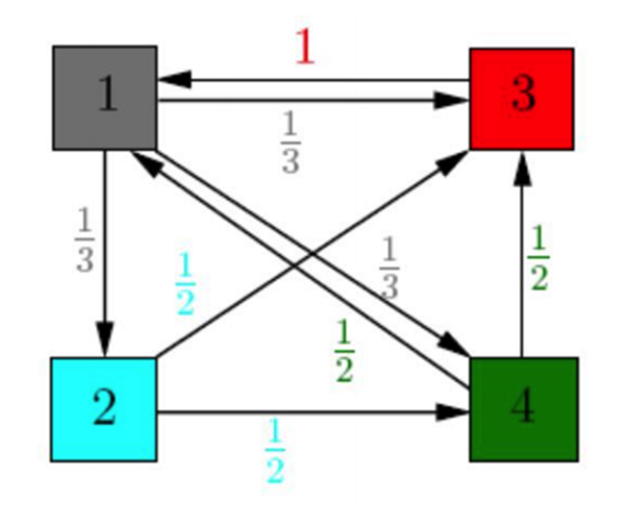
BIG DATA
Problem Statement
Find the ranks of the 4 pages whose links have been given in the input file after 5 iterations of PageRank
Node/ Page | Edges/Hyperlinks
1 | 3
1 | 2
1 | 4
2 | 3
2 | 4
3 | 1
4 | 3
4 | 1

Slide 18
BIG DATA
Recall: Log Mining Example
Read Rdd
Filtered Rdd
Cached Rdd
Count() - acion
distributed
How is this executed by Spark?

Slide 19

BIG DATA
Spark Architecture
Requests cluster manager for workers to run operations
This is the master for your spark application
The driver packages the transformations and actions and creates tasks on workers
https://spark.apache.org/docs/latest/cluster-overview.html

Slide 20
THANK YOU

